Slide 1
Mid-Sprint review
The Shadows of Vahlvadell

Slide 2
Finished the Inventory System
Finished handling all operations except stacking
Adjusted the system for multiplayer (Added replication)
Defined, optimised, and implemented the Inventory Item lifecycle
Finalized the UML
Aaron Stevens & Gracjan Blazejowski

Slide 3
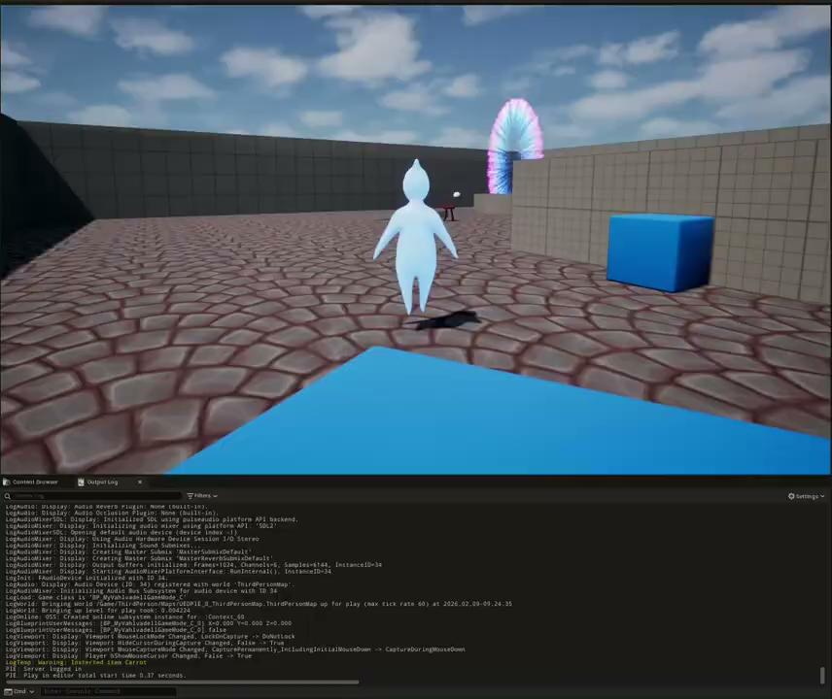

Slide 4
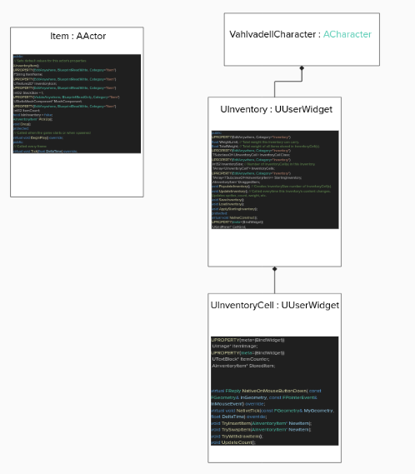
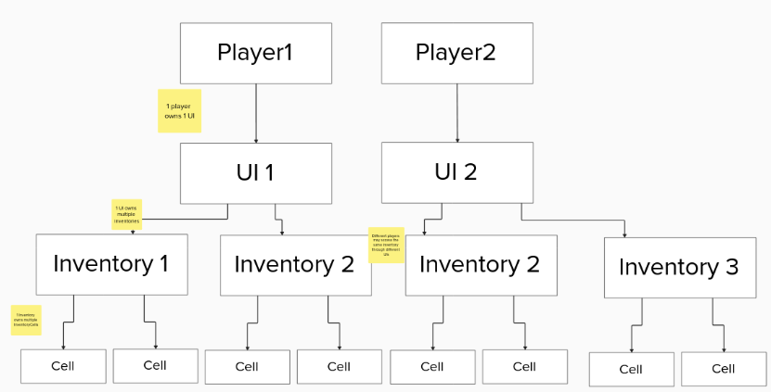

Slide 5
Implemented Optimisation Settings
The optimisation settings have been bound to a UI and mapped to the keyboard.
Sergio Eneide

Slide 6

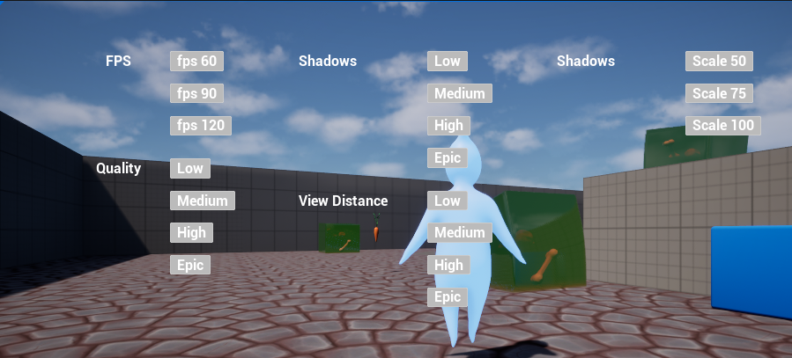

Slide 7
Started work on the Attack animation
Joshua Keitany

Slide 8
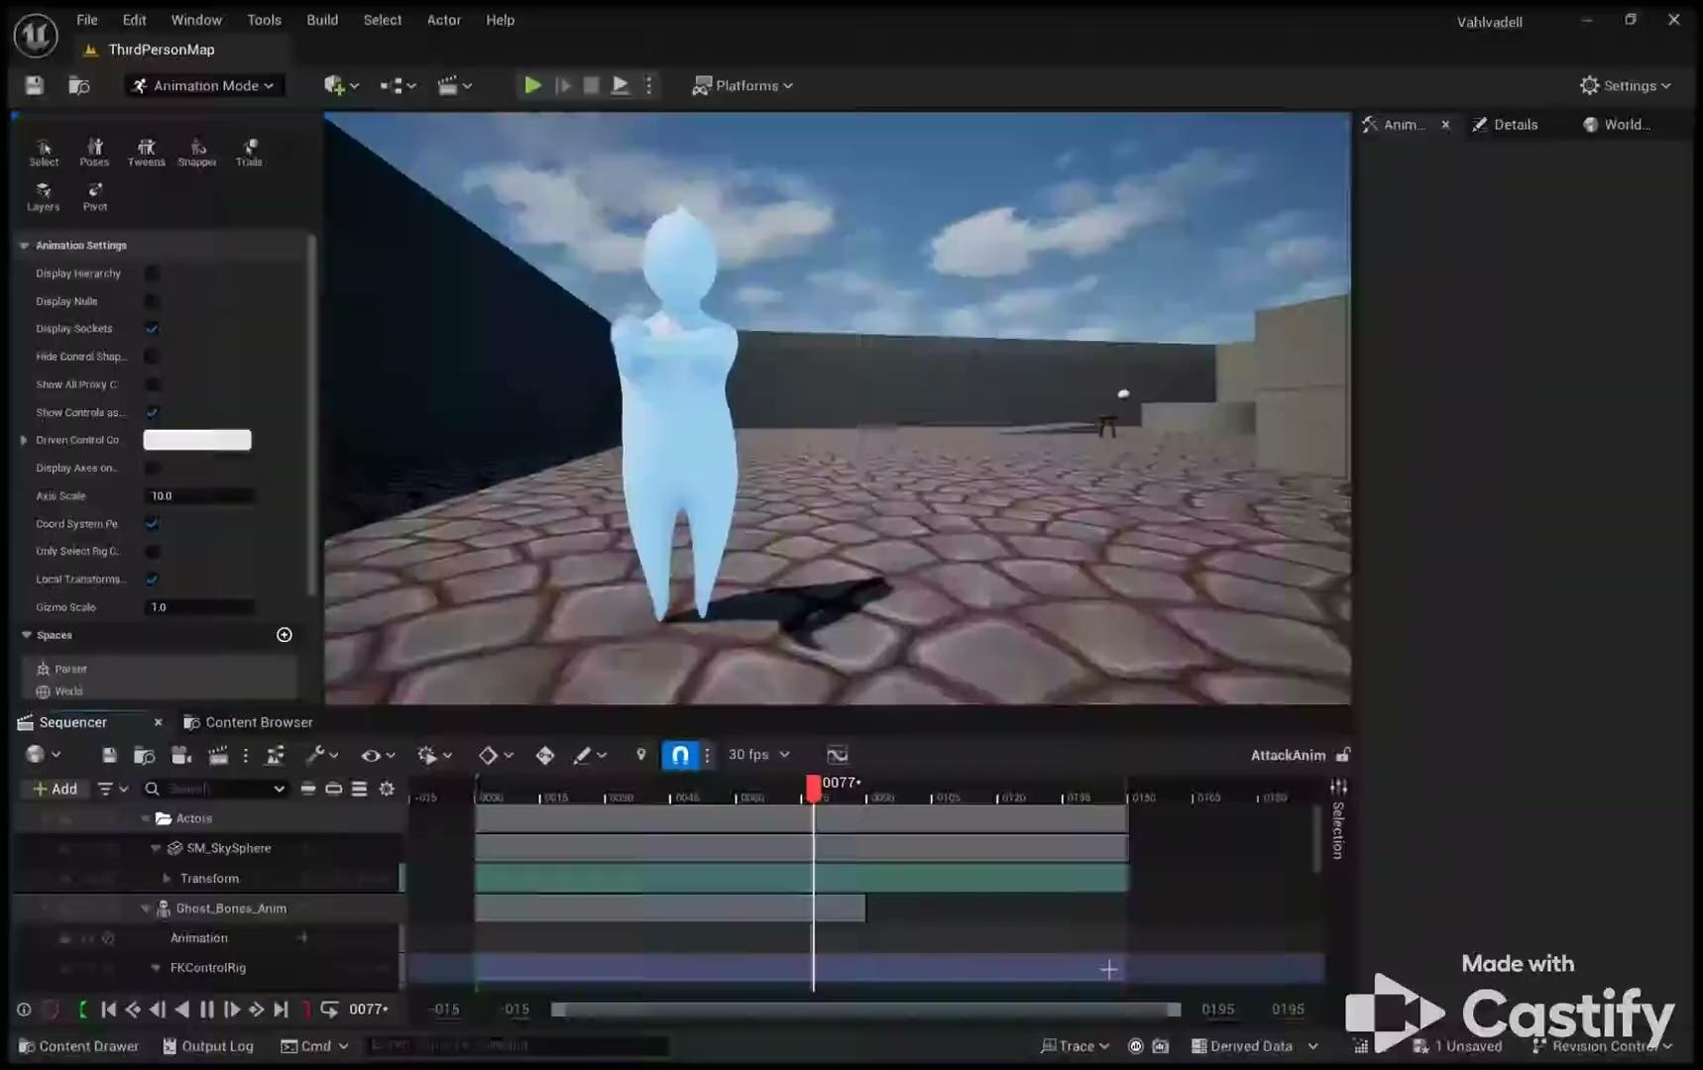

Slide 9
Thank you

